Slide 1
INTERNET FOR ALL:
CONNECTING THE COMMONWEALTH OF Pennsylvania
PBDA Board Meeting: June 1, 2023

Slide 2
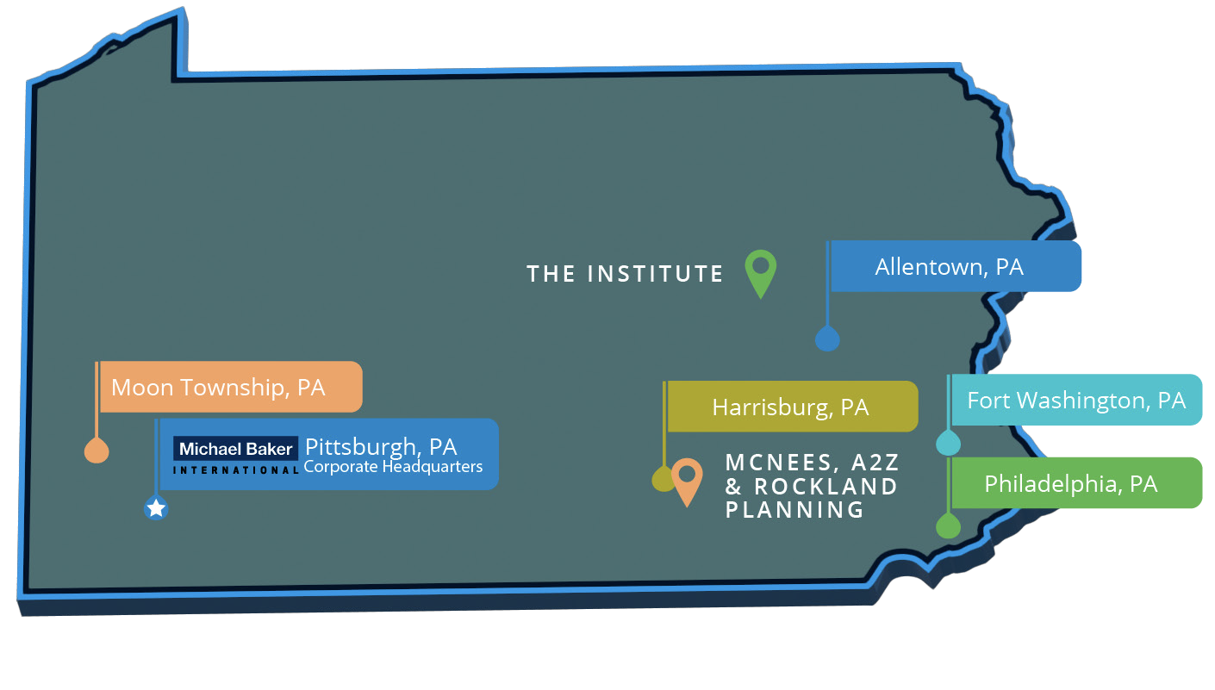
Our bead and digital equity planning team
Michael Baker International (MBI)
  Steve Barber, PE, Sr VP, Project Principal
  Beth Crow, Engagement Lead
  Kirsten Compitello, AICP Digital Equity Plan Lead
  Teraira Snerling, Five Year Action Plan Lead
Planning & policy subconsultants:
  Rockland Planning
  McNees Strategic Solutions Group, LLC
  A2Z Diversity Solutions
Survey implementation subconsultant:
  The Institute

Slide 3
Our commitment to collaboration
Weekly standing meetings with PBDA staff
Regular communication as needed
Biweekly standing meeting participation and review throughout plan development
2 PBDA staff
1 Board representative
4 Sub-committee chairs
Digital equity representatives
Monthly Board meeting presentation and status updates
Board will review and approve both Plans prior to NTIA submission dates
MBI presentation and discussion at all sub-committee meetings through 5 Year Action Plan completion; and relevant sub-committee meetings through Digital Equity Plan completion

Slide 4
schedule
FCC Broadband Map & funding allocations expected
6/1
6/30
tentative
7/25
8/12
mid-September
10/31
PBDA Board meeting
80% DRAFT
PBDA Board meeting, before Final
FINAL to PBDA
NTIA Submission: 5 Year Action Plan
FINAL to PBDA
NTIA Submission: Digital Equity Plan
5 YEAR ACTION PLAN
Board approval
DIGITAL EQUITY PLAN
30 day
Public comment period
5 YEAR ACTION PLAN
>> DEVELOPMENT <<
5 YEAR ACTION PLAN
>> COMPLETION <<
DIGITAL EQUITY PLAN
>> DEVELOPMENT <<
DIGITAL EQUITY PLAN
>> COMPLETION <<
PUBLIC ENGAGEMENT
For inclusion in both Plans
PUBLIC ENGAGEMENT
For inclusion in Digital Equity Plan

Slide 5
Funding implications
BROADBAND ACCESS, EQUITY, AND DEPLOYMENT (BEAD)
  5 Year Action Plan
    Planning Grant funds received
  Initial Proposal
    Due December 2023
  Final Proposal
    Due after Initial proposal review, challenges, continued public engagement, and revisions are completed.
    Full BEAD funds will be available at this time.
DIGITAL EQUITY ACT
  Digital Equity Plan
    Planning Grant funds received
  Capacity Grant
    Available to the Commonwealth in 2024
  Competitive Grant
    Available to the all eligible entities, not limited to states, in 2024

Slide 6
Task 1: project management and engagement
2 day Kickoff
  Held May 17-18
Project Coordination
  Weekly meetings with PBDA
  Weekly activity progress tracking
Strategy Support
  Strategic planning session with PBDA
  Stakeholder analysis & database management
Public Engagement
  20 community events
  4 Roundtables
  Communications Toolkit
  PBDA Subcommittee meetings
  PBDA Board Meetings
  Statewide survey
  Other stakeholder involvement (including stakeholder working group participation, follow-up interviews, and a questionnaire)
  And public engagement event tracking to meet NTIA requirements

Slide 7
Task 2: 5 year action plan
Current State of Broadband
  Broadband Asset Inventory
  Existing programs, funding sources, planned projects, and capacity
  Existing partners
Barriers and Obstacles
  Assessment of known or anticipated barriers
Local Coordination
  Engagement to guide the 5 Year Plan
  A plan for continued local/ stakeholder collaboration and coordination
Implementation Steps
  Goals and strategies
  Broadband Readiness Framework and Checklist
  High-level plan for universal service, including timeline and costs
  Digital equity and inclusion goals
  Plan alignment with other statewide connectivity priorities
    Local/county broadband plans
    Other relevant and connected efforts across sectors, i.e. economic development

Slide 8
Task 3: digital equity plan
Barriers and Needs Assessment
  Digital Equity Asset Inventory
  Stakeholder Inventory Questionnaire
  Deep Dive Stakeholder Interviews
  Incorporation of Localized Digital Equity Plans
Development of an Implementation Strategy
  Measurable Objectives (goals)
  Performance Standards
  Best Practices and NDIA Collaboration
  Partnerships for Implementation
Coordinated Stakeholder Outreach
Final Plan
  Prefinal to PBDA
  30-day Public Review and comment period
  Comment tracker monitored and completed
  Final Plan completed for NTIA submission

Slide 9
Timeline – ongoing Public Engagement
Fall 2022 – Spring 2023
June-July
*into August as needed
Fall 2023 – 2024
PBDA Engagement statewide
Visits to county leaders across PA
Listening sessions
County leaders survey
Primary period of public engagement for the 2 Plans
20 Community Conversations (in-person)
5- 6 Roundtables
(some in-person, some virtual)
Biweekly Stakeholder Working Group meetings
Public Survey
Targeted outreach via a questionnaire and follow-up interviews
PBDA Continued Local Coordination required
The following are PBDA steps that will follow after the Plans are submitted.
The Initial Proposal requires public outreach and a 30 day public comment period.
The Final Proposal requires repeated public outreach.

Slide 10
INTERNET FOR ALL:
CONNECTING THE COMMONWEALTH OF Pennsylvania
Public Engagement for the BEAD Five-Year Action, and Digital Equity Plans
June 1, 2023
Pennsylvania Broadband Development Authority

Slide 11
NTIA Objectives for Public Engagement
Notice of Funding Opportunities (NOFO) for both the Broadband, Equity, Access & Deployment (BEAD) Program and the Digital Equity (DE) Act Program includes requirements for local coordination. PDBA will track stakeholders, activities, local plans, and feedback and comments.
Covered Populations (DE) & Underrepresented Communities (BEAD)
Individuals who live in covered households
Aging Individuals
Incarcerated Individuals (not in federal correctional facility)
Veterans
Individuals with Disabilities
Individuals with a Language Barrier
Individuals who are members of a Racial or Ethnic Minority Group
Individuals who reside primarily in rural areas
Persons of color (DE only)
Women (DE only)
LGBTQ+ persons (DE only)
Persons otherwise adversely affected by persistent poverty or inequity (DE only)
Indigenous and Native American persons (DE only)
Organizations & Stakeholder Groups
Community Anchor Institutions
County/Municipal Governments
Nonprofit Organizations
Civil Rights Organizations
Educational Agencies
Workforce Development Organizations
Public Housing Authorities
Labor Organizations/Unions
Faith-Based Organizations
Higher Education Institutions
Internet Service Providers
Public Utility Commissions
Economic Development Organizations
Advocacy Groups
Local Businesses

Slide 12
Public Engagement – 4 Key Components
Community Conversations
Community residents, community leaders, local nonprofits, local elected officials, community- and faith-based organizations.
Community-Serving Stakeholder Roundtables
Community anchor institutions, coalitions/associations, State agencies (e.g. housing, transportation, public works)
Thematic Roundtables
Industry Roundtable: Broadband service providers, wireless providers, Public utilities commissions; Workforce Development Roundtable
Surveys and Questionnaires
A statewide resident survey, and targeted questionnaires prepared for the stakeholder working group, state agencies, and a sampling of community organizations. Results from a local government survey conducted previously in 2022 by PBDA will be incorporated.

Slide 13
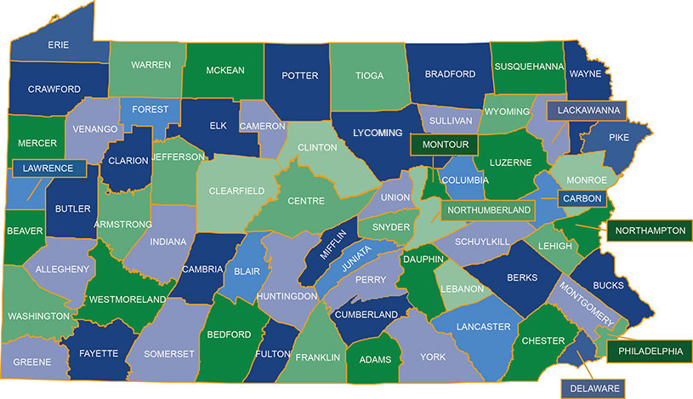
Community Conversations Roundtables
Existing community partner events that PBDA may participate in, but not cohost.

Slide 14
Timeline – Public Engagement events
June 5-9
June 11-17
June 19-23
June 26-29
July
August
Community Conversations:
Beaver
Berks
Columbia
Erie
Lehigh
Roundtable – NTIA (BEAD) 7/13 PSU
Roundtable – Lancaster
Date TBD
Roundtable – Industry Partners
Virtual
DE Survey Deployed State-wide
Community Conversations:
Carbon
Huntingdon
Somerset
Washington/Greene
Roundtable – BEAD/DE Indiana
Community Conversations:
Clearfield
McKean/Potter
Philadelphia (x2)
Tioga
Venango/Clarion
Lackawanna
Roundtable – Workforce Development: Virtual
Community Conversations:
Dauphin
York
Delaware
Roundtable – BEAD/DE
Virtual

Slide 15
Community Conversation Cohost Requirements
Well respected in, and well connected to, their larger community.
Proactively engage other regional stakeholders to amplify and attend event (school district, libraries, nonprofits, social service providers, coalitions, etc.).
Send event invitations.
Broadly publicize event via traditional and social media (flyers and related materials will be provided for you to share).
Encourage attendance to event.
Provide opening remarks at event.
Provide location.
    Large meeting space to accommodate at least 20 and up to 50
    Handicap accessible space
    Food and beverages permitted in the room
    Tables/chairs available for use
    Screen with computer connectivity for PowerPoint presentation if possible (if not, hard copies of presentation will be provided)

Slide 16
Community Conversation Cohost Toolkit
Meeting-In-A-Box provided to
cohosts:
Invitation text (email)
Social media posts (for Facebook and Twitter)
Newsletter insert (customizable)
Email blast text
Promotional flyer
Press release (customizable)
Outdoor signage
PBDA will cover costs for:
Food/beverages
Transportation vouchers (if served by transit)
Printing
Space rental (if necessary)
Additionally, PBDA/MBI will provide paper questionnaire for participants; and a family-friendly setup including activities such as coloring books and crayons for children.

Slide 17
Kirsten.Compitello@mbakerintl.com
(Digital Equity Plan Lead)
Elizabeth.Crow@mbakerintl.com
(Engagement Lead)

Slide 19
Broadband Equity, Access, and Deployment (BEAD) Program
PA was awarded $5 million in planning funds to prepare a statewide 5 Year Action Plan.
This 5 Year Action Plan is due at the end of July – for PBDA approval and submission to the NTIA by August 12.
The 5 Year Action Plan includes:
  Broadband assets: including infrastructure, human resources, state capacity to manage programs (including grants)
  Barriers and obstacles to equitable access and use
  Goals and strategies to achieve universal broadband access across the state
  Partners to work with in implementing projects and programs
  Ongoing local& stakeholder coordination

Slide 20
Broadband Equity, Access, and Deployment (BEAD) Program
After the 5 Year Action Plan is completed, what next?
PA will receive additional funds to construct and deploy broadband projects, and implement programs to assist with adoption and awareness.
  At least $100 million is guaranteed
  Over $1 billion is expected
  The exact quantity of funds for PA are anticipated to be announced by the NTIA by June 30, 2023
When will we see those funds?
  Not right away!
  The State must prepare more detailed documents (Initial and Final Proposal). These will describe labor standards, environmental review, grant application processes guiding how the State will allocate funds to service providers, counties, municipalities, etc.; and more.
  The full BEAD funds for implementation will be available after these are complete and approved by the NTIA.

Slide 21
Digital equity act
PA was awarded $1.6 million in planning funds to prepare a statewide Digital Equity Plan.
This Digital Equity Plan includes a public comment period:
September – Prefinal
Mid-September to mid-October – 30 day public comment period
October 31 – Due to NTIA
The Digital Equity Plan includes:
  Asset Inventory: this is really about resources and the work you all do! Programs, staff capacity, and community organizations that are involved in offering or supporting digital equity activities
  Goals and strategies to achieve sustainable, lasting outcomes for access, skills, affordability, and more
  Partners to work with in implementing projects and programs
  Barriers and local& stakeholder coordination are key to this Plan also.

Slide 22
Digital equity act
After the Digital Equity Plan is completed, what next?
The NTIA has two additional grants that will become available:
  Capacity Grant
  Available to States to implement the Digital Equity Plan
  Competitive Grant
  Available to eligible entities (private sector, public sector, and not-for-profit entities) with a purpose to advance digital equity and digital inclusion activities
How will these grants be allocated?
  To be determined. Each State will create their own process for allocating subgrants.
  The Digital Equity Plan will serve as a guide in allocating grants for implementation.

Slide 23
schedule
6/1
6/30
tentative
7/25
8/12
mid-September
10/31
PBDA Board meeting
80% DRAFT
PBDA Board meeting, before Final
FINAL to PBDA
NTIA Submission: 5 Year Action Plan
FINAL to PBDA
NTIA Submission: Digital Equity Plan
5 YEAR ACTION PLAN
>> DEVELOPMENT <<
6/8 - Technical Sub-committee
6/14 - Outreach & Education Sub-committee
6/21 - Workforce
Sub-committee
5 YEAR ACTION PLAN
>> COMPLETION <<
7/13 - Outreach & Education Sub-committee
7/13 – NTIA Internet For All Roundtable
5 YEAR ACTION PLAN
Board approval
DIGITAL EQUITY PLAN
30 DAY PUBLIC COMMENT PERIOD
DIGITAL EQUITY PLAN
>> DEVELOPMENT <<
DIGITAL EQUITY PLAN
>> COMPLETION <<
PUBLIC ENGAGEMENT
For inclusion in both Plans
PUBLIC ENGAGEMENT
For inclusion in Digital Equity Plan

